Slide 1

Université de Mostaganem — Dr. Madani BELACEL
ICT Tutorial 05 — Microsoft Excel: Basics and Academic Uses
Module TIC — Dr. BELACEL Madani
Université de Mostaganem — MCB

Slide 2
Université de Mostaganem — Dr. Madani BELACEL
🎯 Objectifs pédagogiques
• Comprendre les concepts clés
• Appliquer les compétences
• Évaluer les technologies

Slide 3
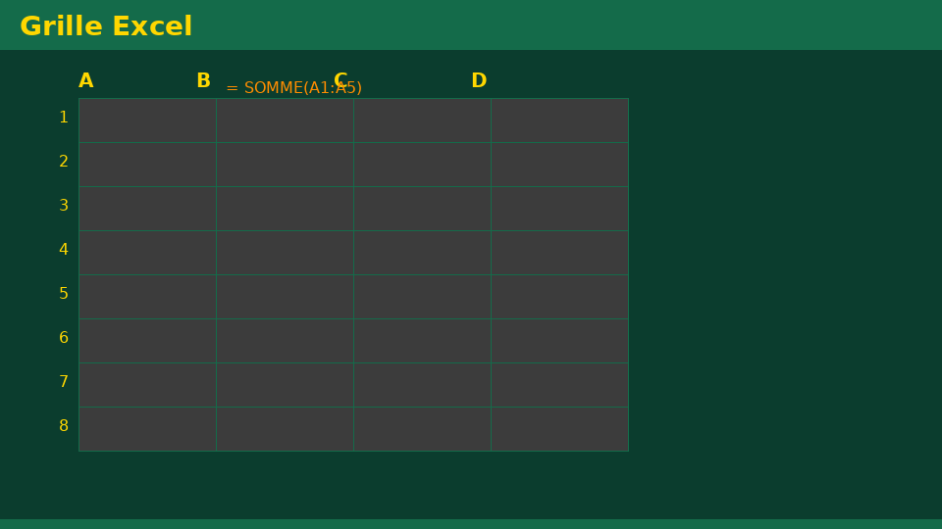
Université de Mostaganem — Dr. Madani BELACEL
📋 Plan du cours
• Exercise 1 — Note table(18 min)
• Exercise 2 — Formulas(18 min)
• Exercise 3 — Absolute references(15 min)
• Exercise 4 — Graph(15 min)
• Exercise 5 — Export(14 min)

Slide 4
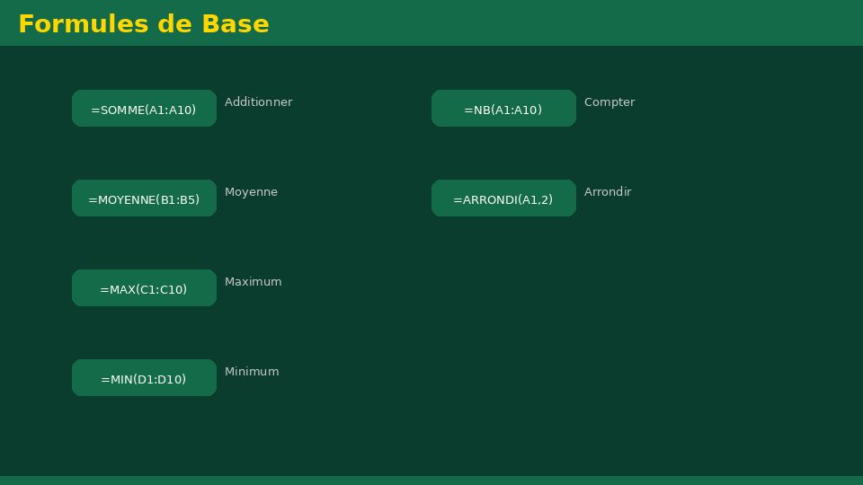
Exercise 1 — Note table(18 min)
• Statement:Create a table for 8 students: Name, TD1 Mark, TD2 Mark, Exam Mark, Average.
• Fixed:Bold headers, aligned columns, thin borders.
Université de Mostaganem — Dr. Madani BELACEL

Slide 5
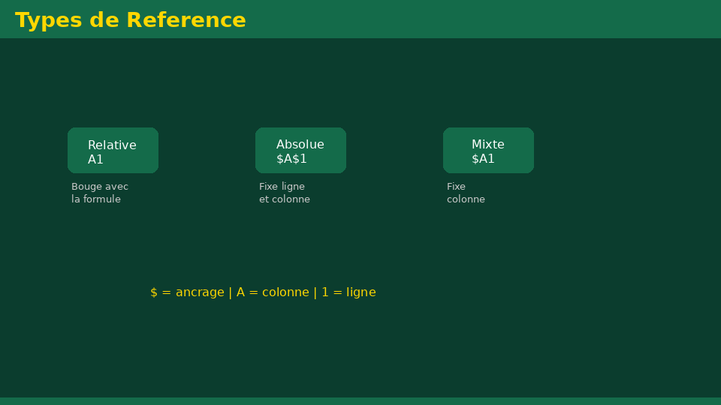
Exercise 2 — Formulas(18 min)
• Statement:Calculate average per student, general average, min and max grade.
• Fixed:=AVERAGE(),=MIN(),=MAX()on correct ranges.
Université de Mostaganem — Dr. Madani BELACEL

Slide 6
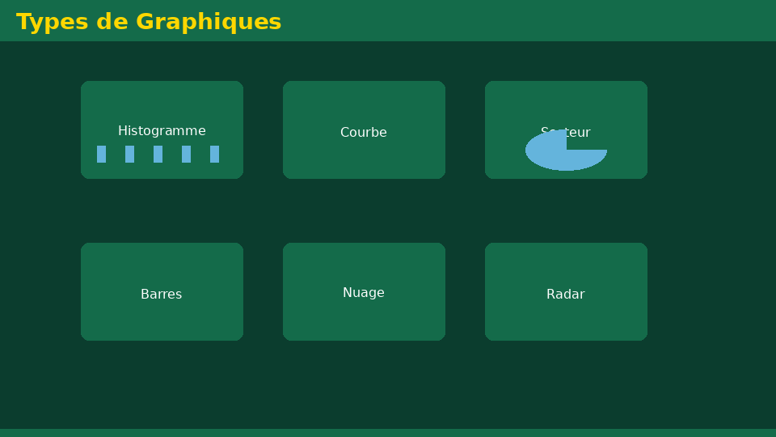
Exercise 3 — Absolute references(15 min)
• Statement:Add a fixed exam coefficient and calculate weighted score.
• Corrected:Coefficient in $G$1, formula with absolute reference F4.
Université de Mostaganem — Dr. Madani BELACEL

Slide 7
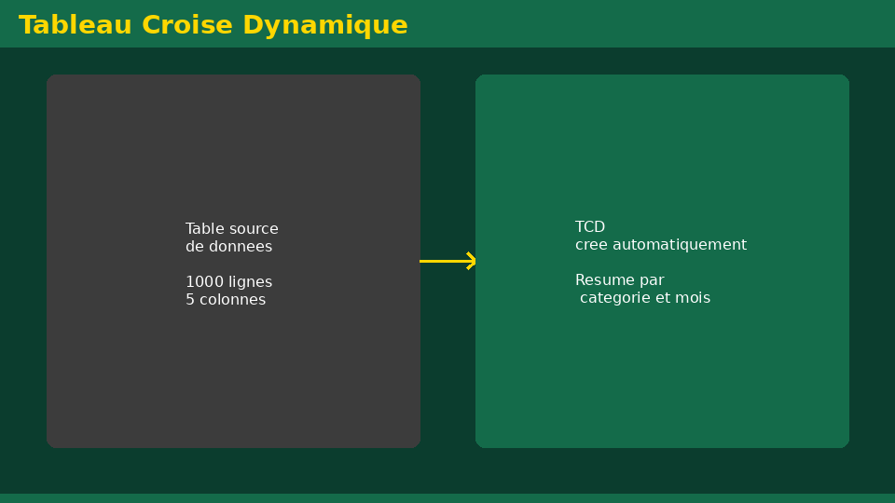
Exercise 4 — Graph(15 min)
• Statement:Histogram of student averages.
• Corrected:Insertion → Histogram, title, legends, no 3D effect.
Université de Mostaganem — Dr. Madani BELACEL

Slide 8
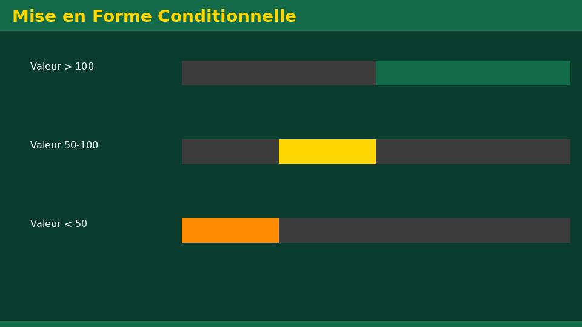
Exercise 5 — Export(14 min)
• Statement:Save as .xlsx and export as PDF.
• Corrected:Naming2026-06-04_TIC_TD5_BELACEL_v1.xlsx+ PDF.
Université de Mostaganem — Dr. Madani BELACEL

Slide 9
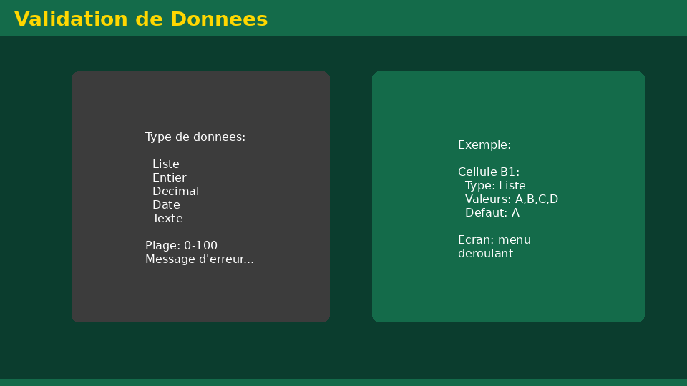
• Statement:Create a table for 8 students: Name, TD1 Mark, TD2 Mark, Exam Mark, Average.
• Statement:Calculate average per student, general average, min and max grade.
• Statement:Add a fixed exam coefficient and calculate weighted score.
📝 Points clés à retenir
Université de Mostaganem — Dr. Madani BELACEL

Slide 10
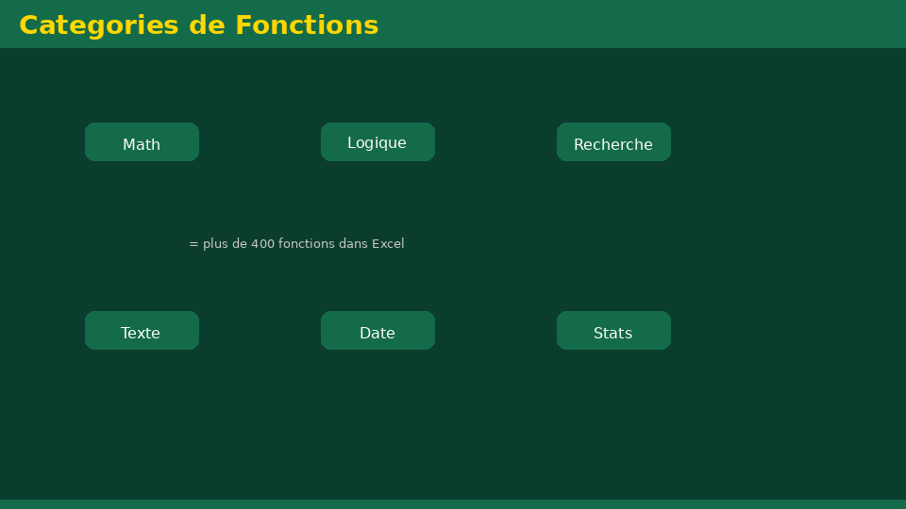
• Statement:Create a table for 8 students: Name, TD1 Mark, TD2 Mark, Exam Mark, Average.
• Statement:Calculate average per student, general average, min and max grade.
• Statement:Add a fixed exam coefficient and calculate weighted score.
📝 Points clés à retenir
Université de Mostaganem — Dr. Madani BELACEL

Slide 11
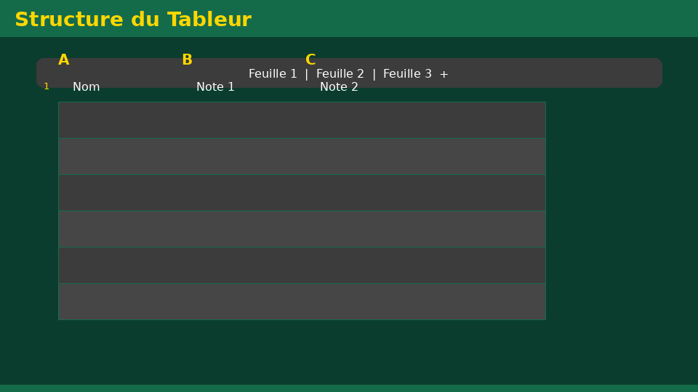
• Statement:Create a table for 8 students: Name, TD1 Mark, TD2 Mark, Exam Mark, Average.
• Statement:Calculate average per student, general average, min and max grade.
• Statement:Add a fixed exam coefficient and calculate weighted score.
📝 Points clés à retenir
Université de Mostaganem — Dr. Madani BELACEL

Slide 12
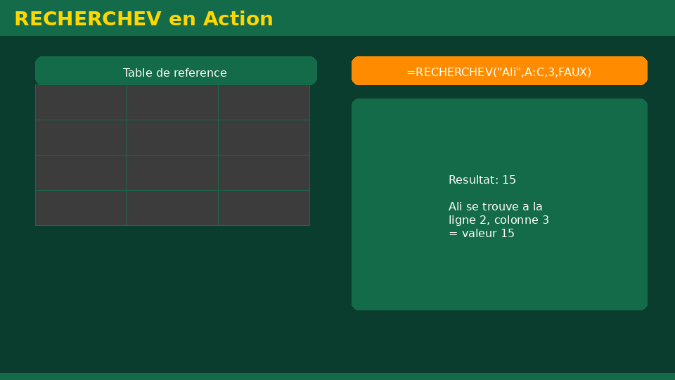
• Statement:Create a table for 8 students: Name, TD1 Mark, TD2 Mark, Exam Mark, Average.
• Statement:Calculate average per student, general average, min and max grade.
• Statement:Add a fixed exam coefficient and calculate weighted score.
📝 Points clés à retenir
Université de Mostaganem — Dr. Madani BELACEL

Slide 13
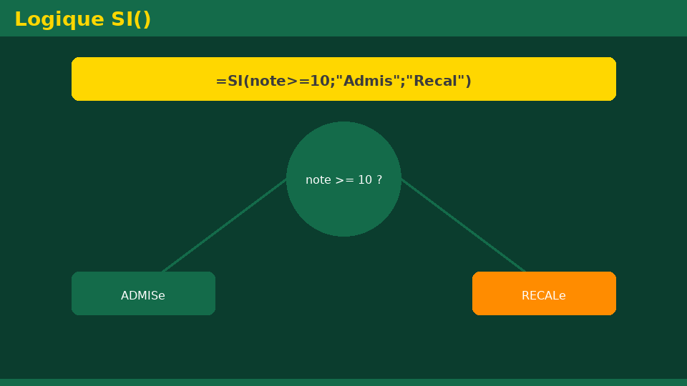
Université de Mostaganem — Dr. Madani BELACEL
📝 Points clés à retenir
• Statement:Create a table for 8 students: Name, TD1 Mark, TD2 Mark, Exam Mark, Average.
• Statement:Calculate average per student, general average, min and max grade.
• Statement:Add a fixed exam coefficient and calculate weighted score.
• Statement:Histogram of student averages.
• Statement:Save as .xlsx and export as PDF.

Slide 14
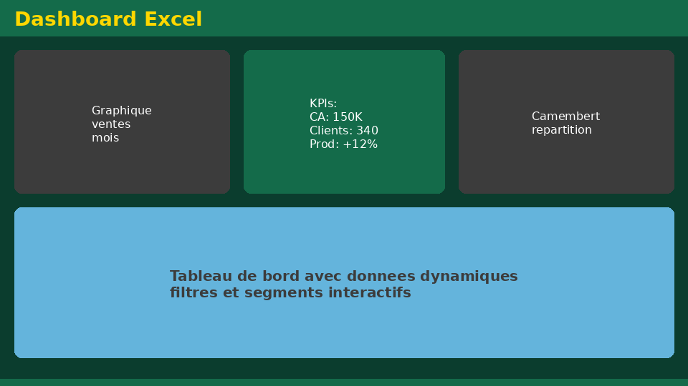
Université de Mostaganem — Dr. Madani BELACEL
✏️ Exercices d'application
• Définir les concepts principaux du cours
• Identifier les applications pratiques
• Résoudre les exercices du TD
• Synthétiser les points clés en un paragraphe
• Préparer une courte présentation orale

Slide 15
Université de Mostaganem — Dr. Madani BELACEL
🎓 Conclusion
Dr. BELACEL Madani Maître de Conférences B Université de Mostaganem madani.belacel@univ-mosta.dz

